Slide 1
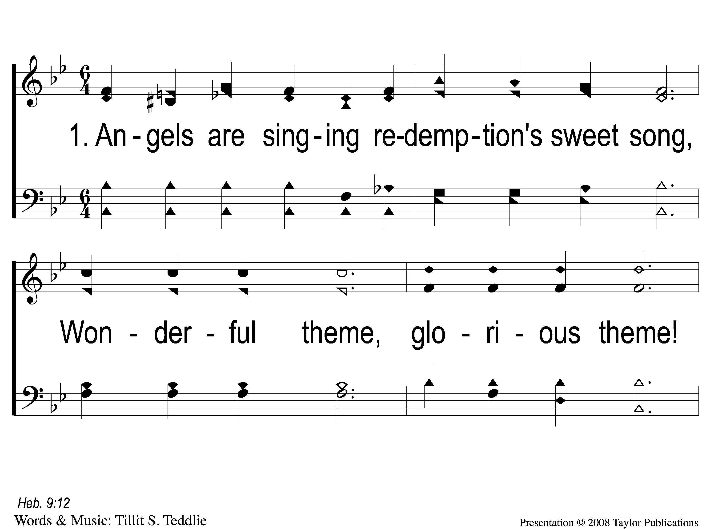
1-1 Angels are Singing
Angels Are Singing
22

Slide 2
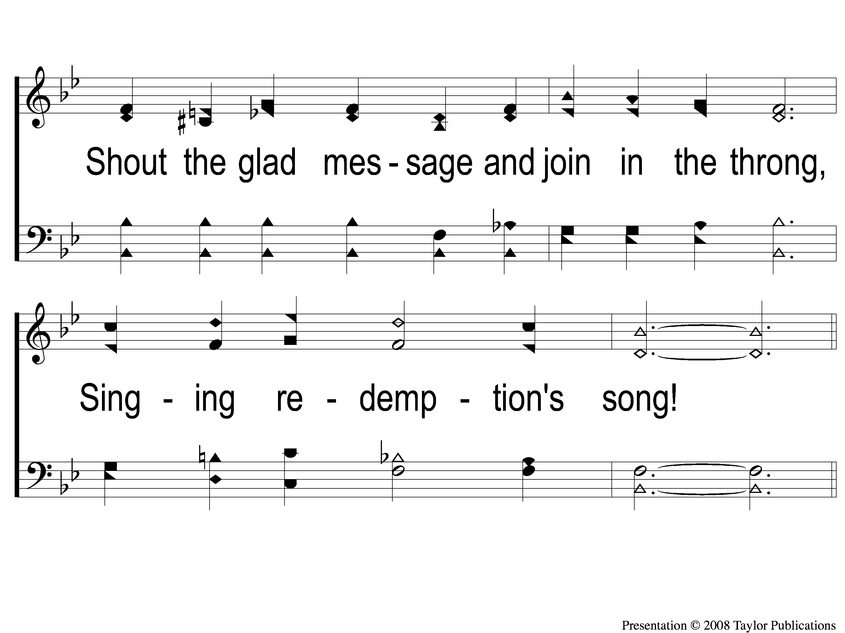
1-2 Angels are Singing
Angels Are Singing
22

Slide 3
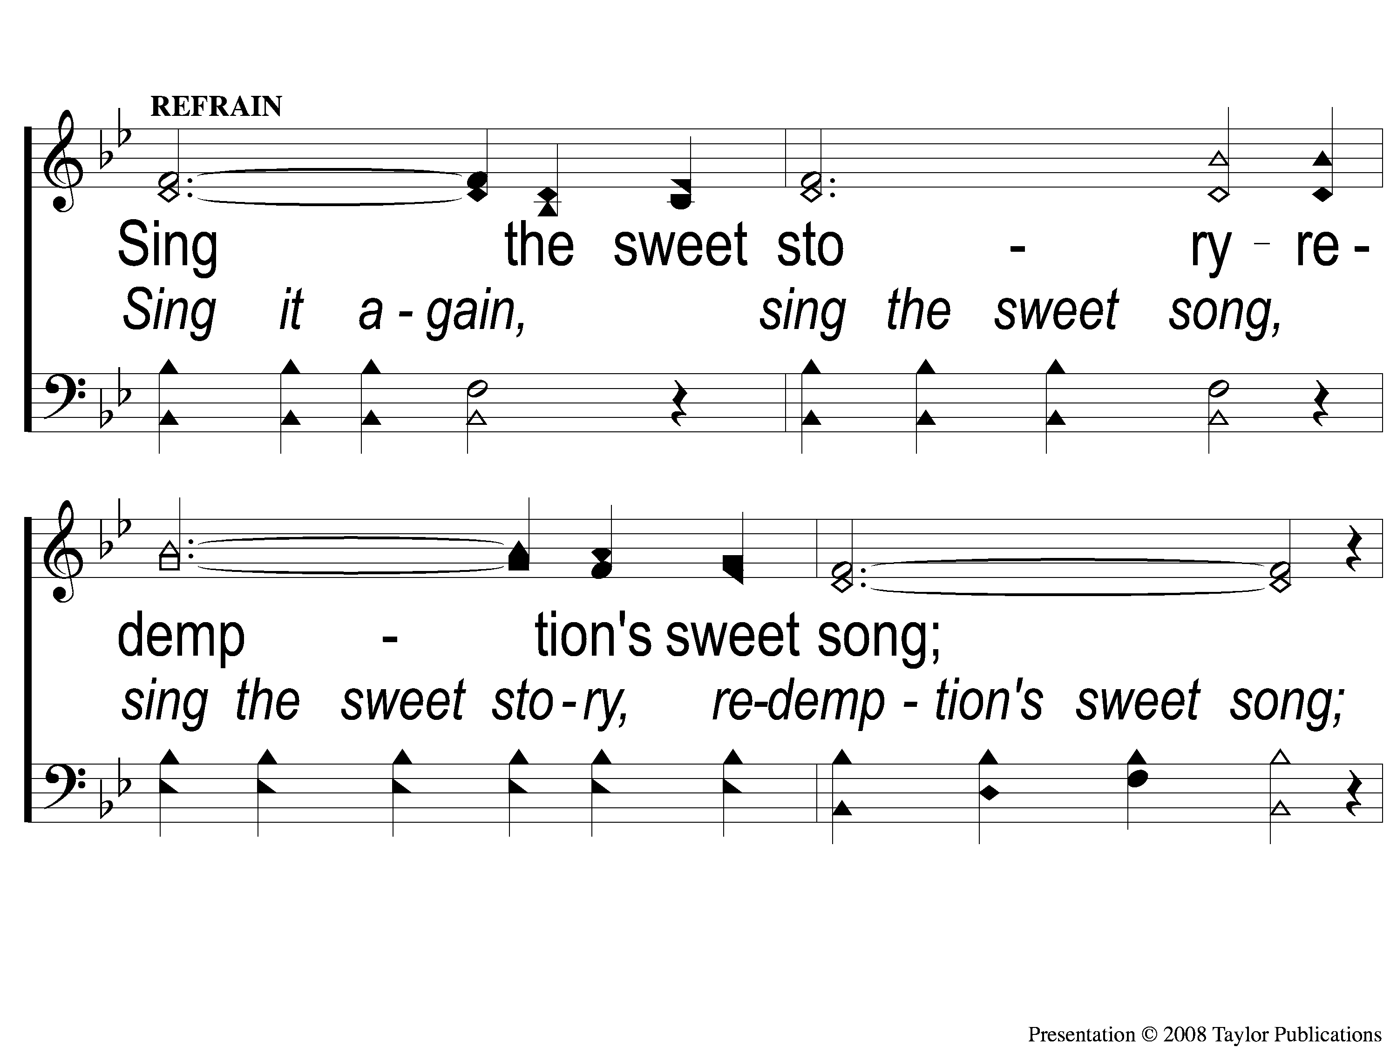
C-1 Angels are Singing
Angels Are Singing
22

Slide 4
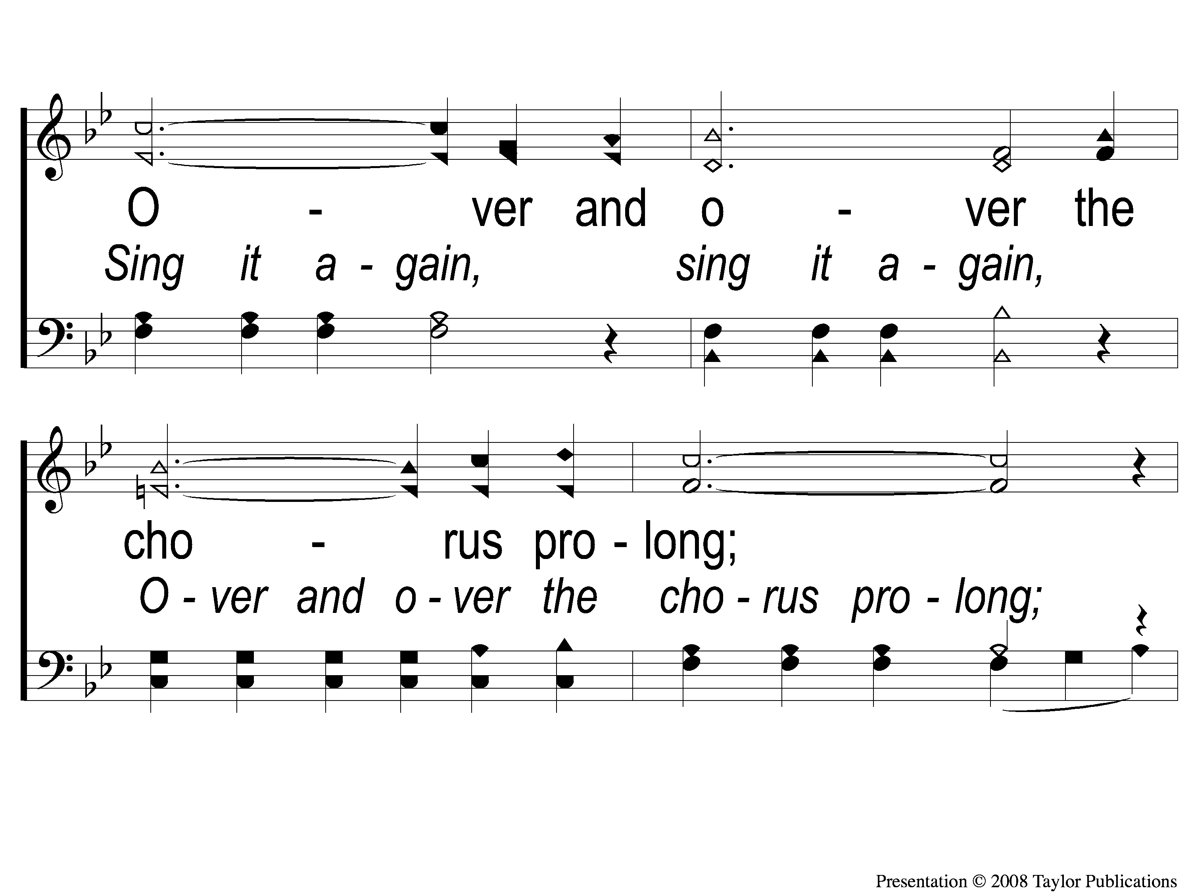
C-2 Angels are Singing
Angels Are Singing
22

Slide 5
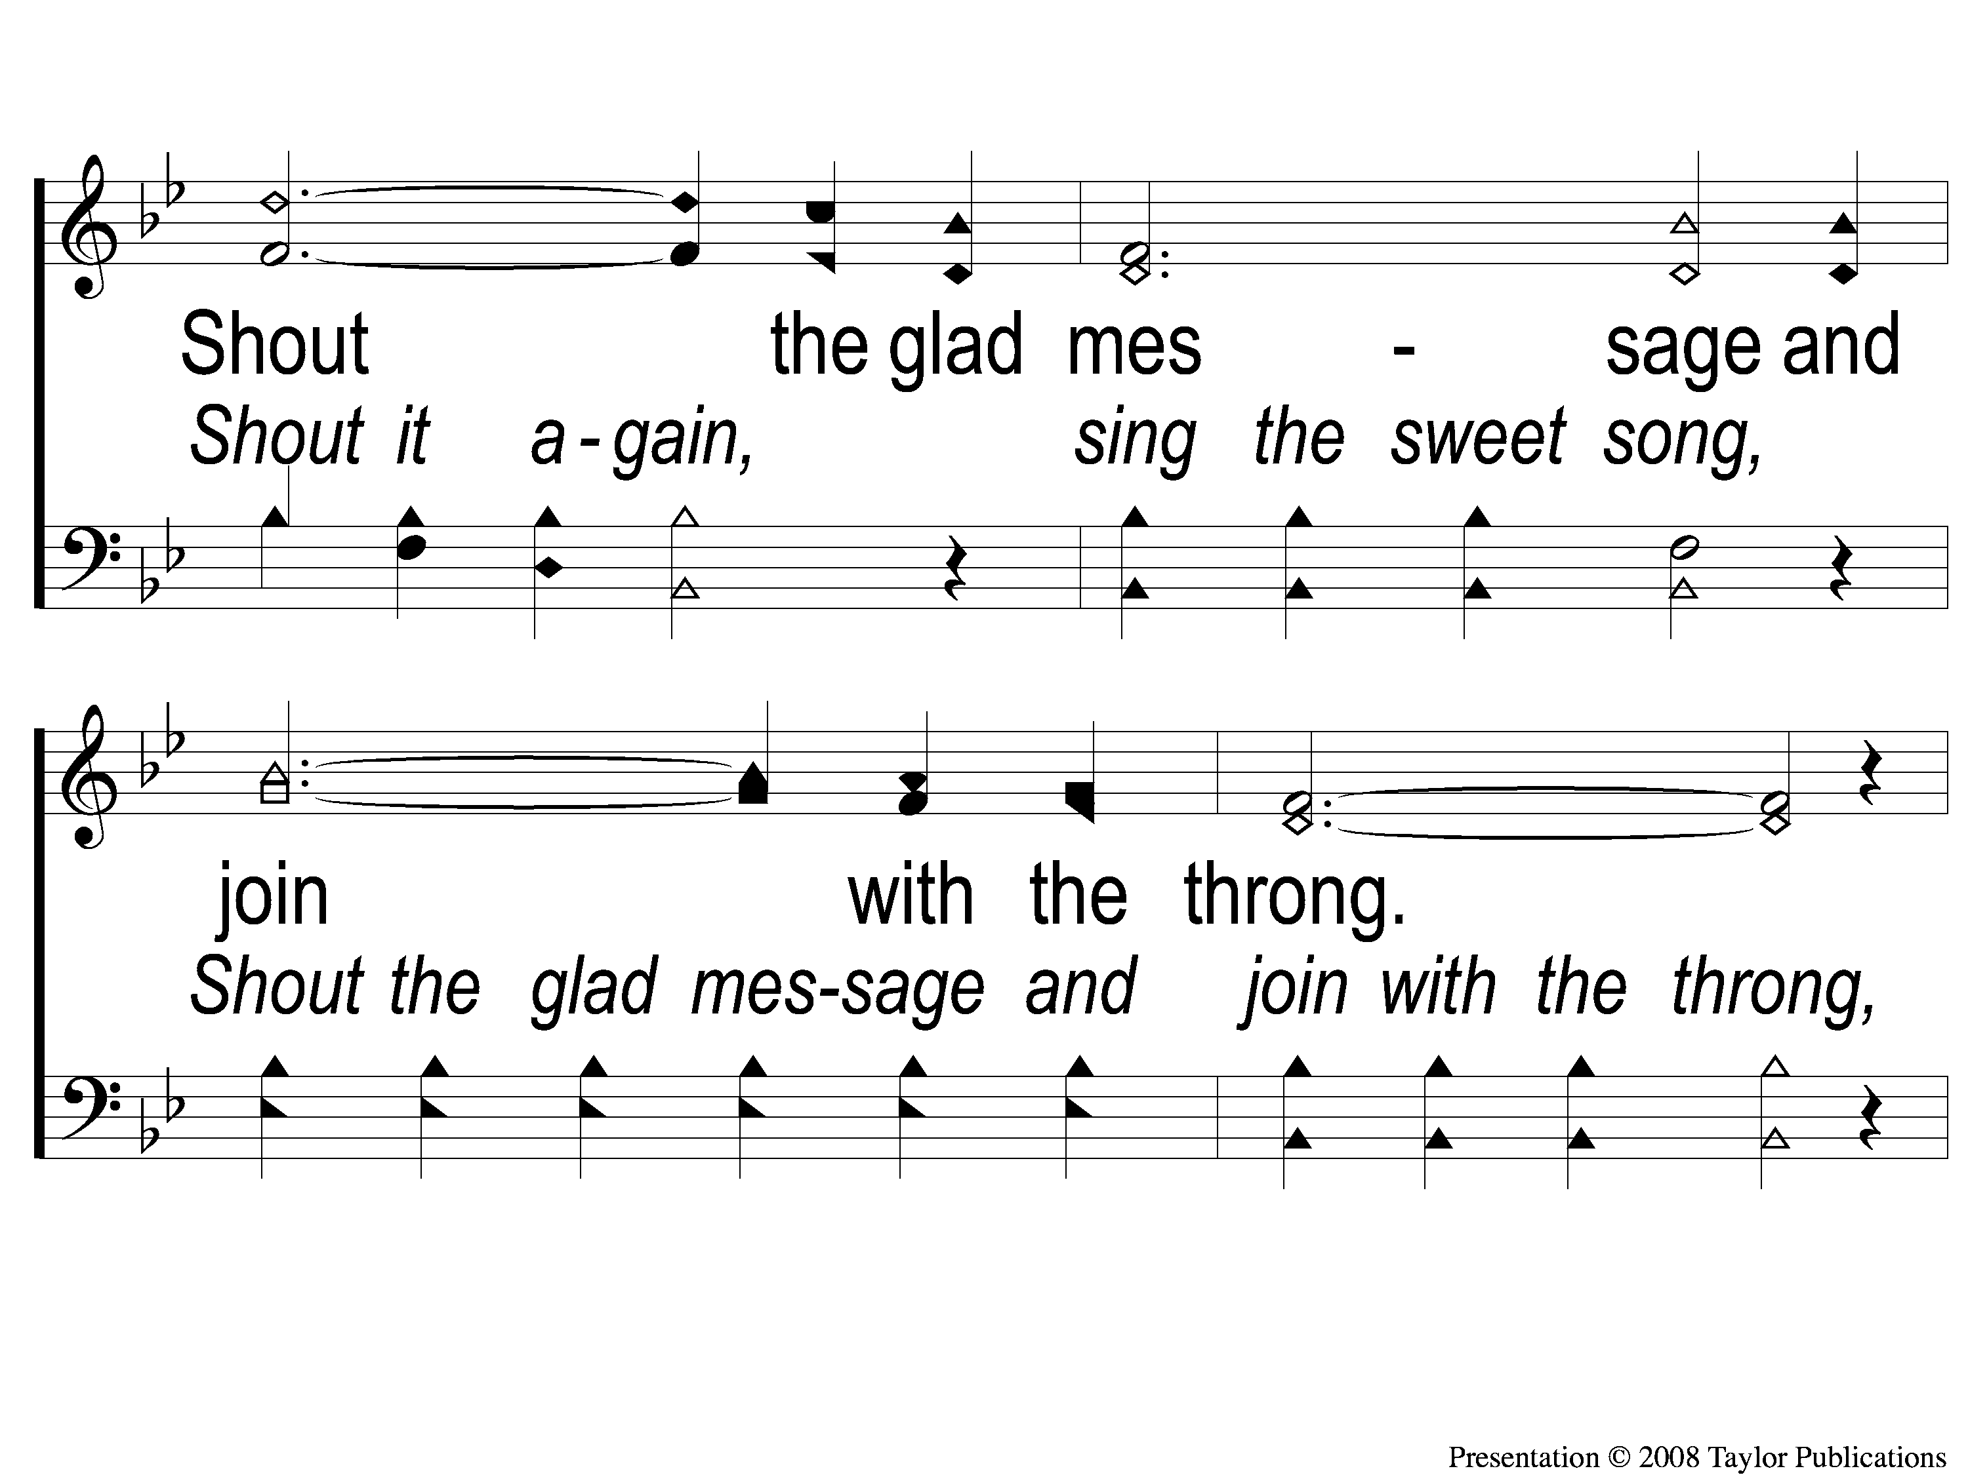
C-3 Angels are Singing
Angels Are Singing
22

Slide 6
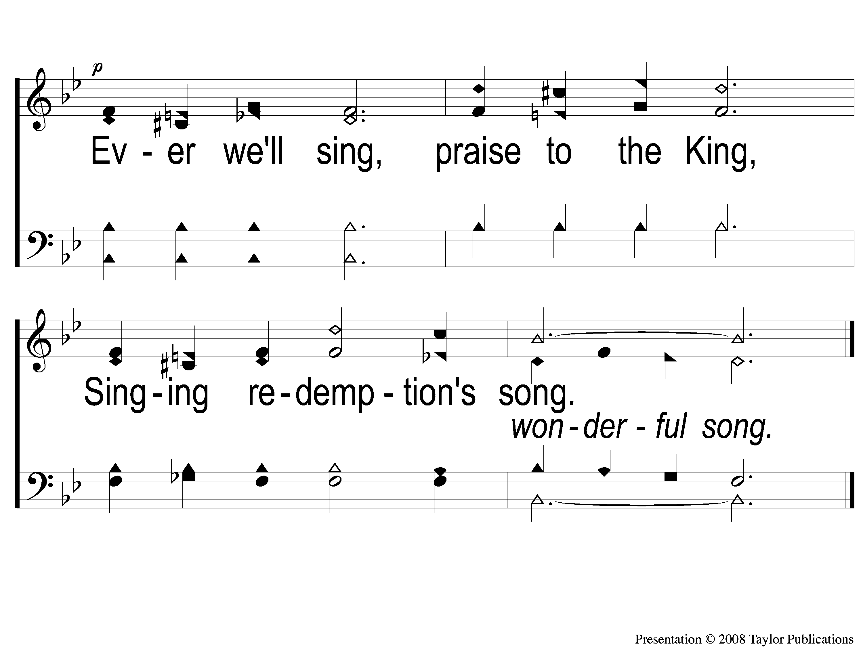
C-4 Angels are Singing
Angels Are Singing
22

Slide 7
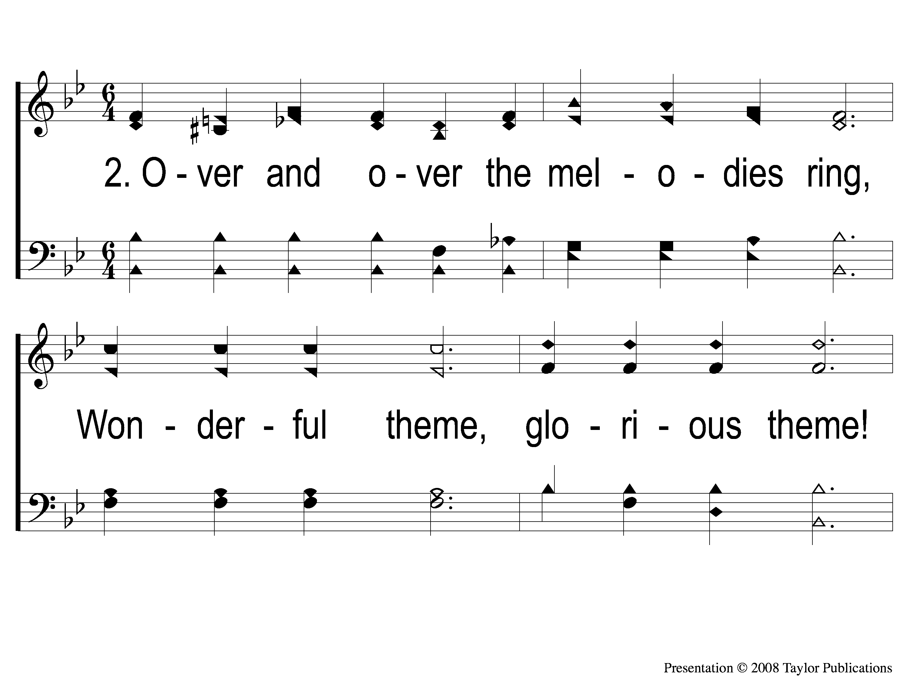
2-1 Angels are Singing
Angels Are Singing
22

Slide 8
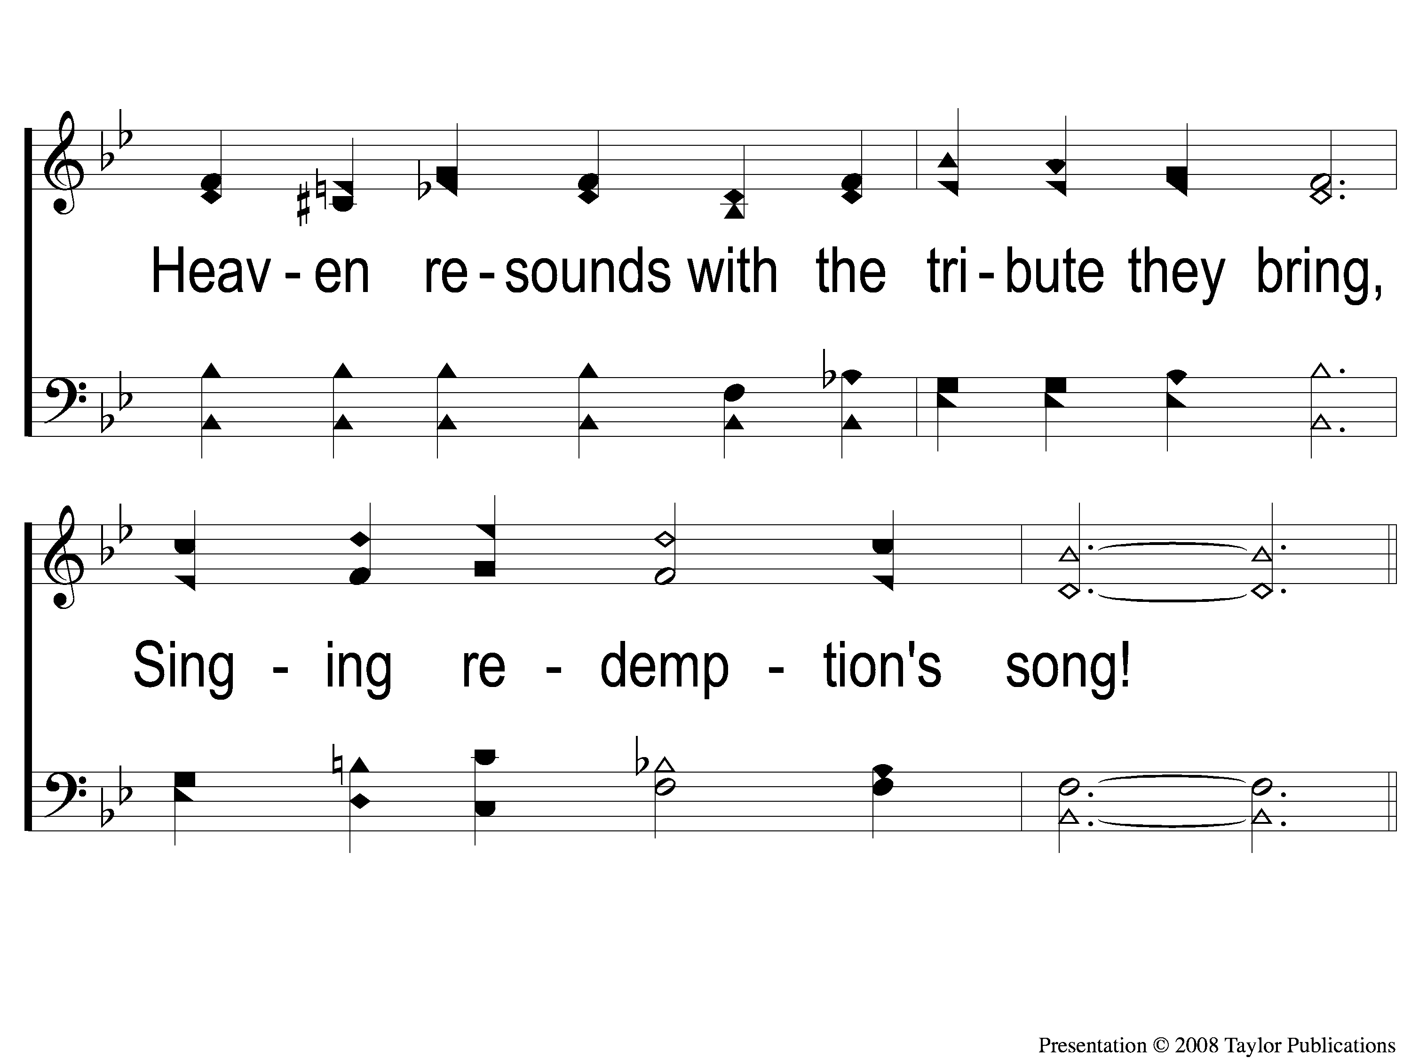
2-2 Angels are Singing
Angels Are Singing
22

Slide 9
C-1 Angels are Singing
Angels Are Singing
22

Slide 10
C-2 Angels are Singing
Angels Are Singing
22

Slide 11
C-3 Angels are Singing
Angels Are Singing
22

Slide 12
C-4 Angels are Singing
Angels Are Singing
22

Slide 13
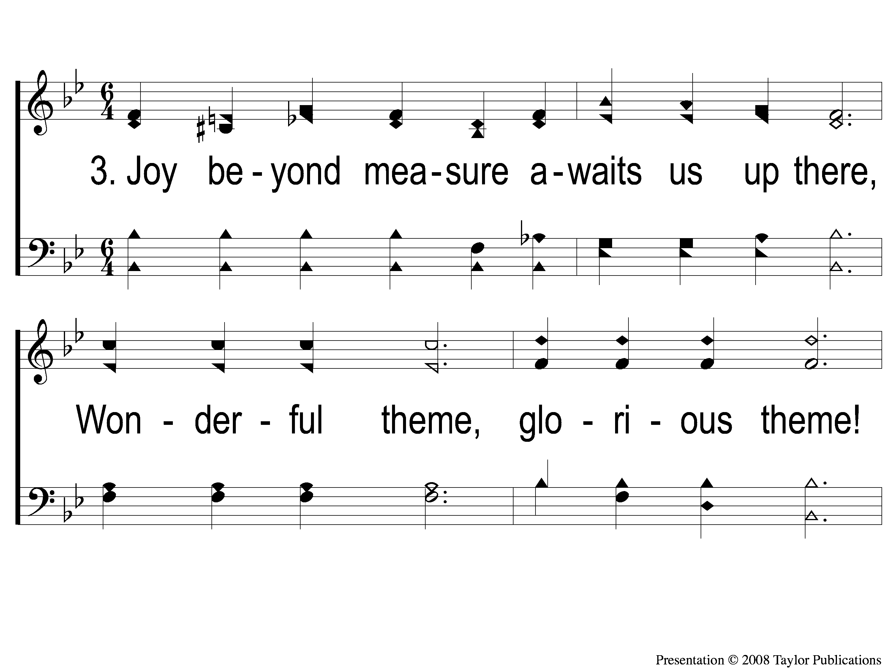
3-1 Angels are Singing
Angels Are Singing
22

Slide 14
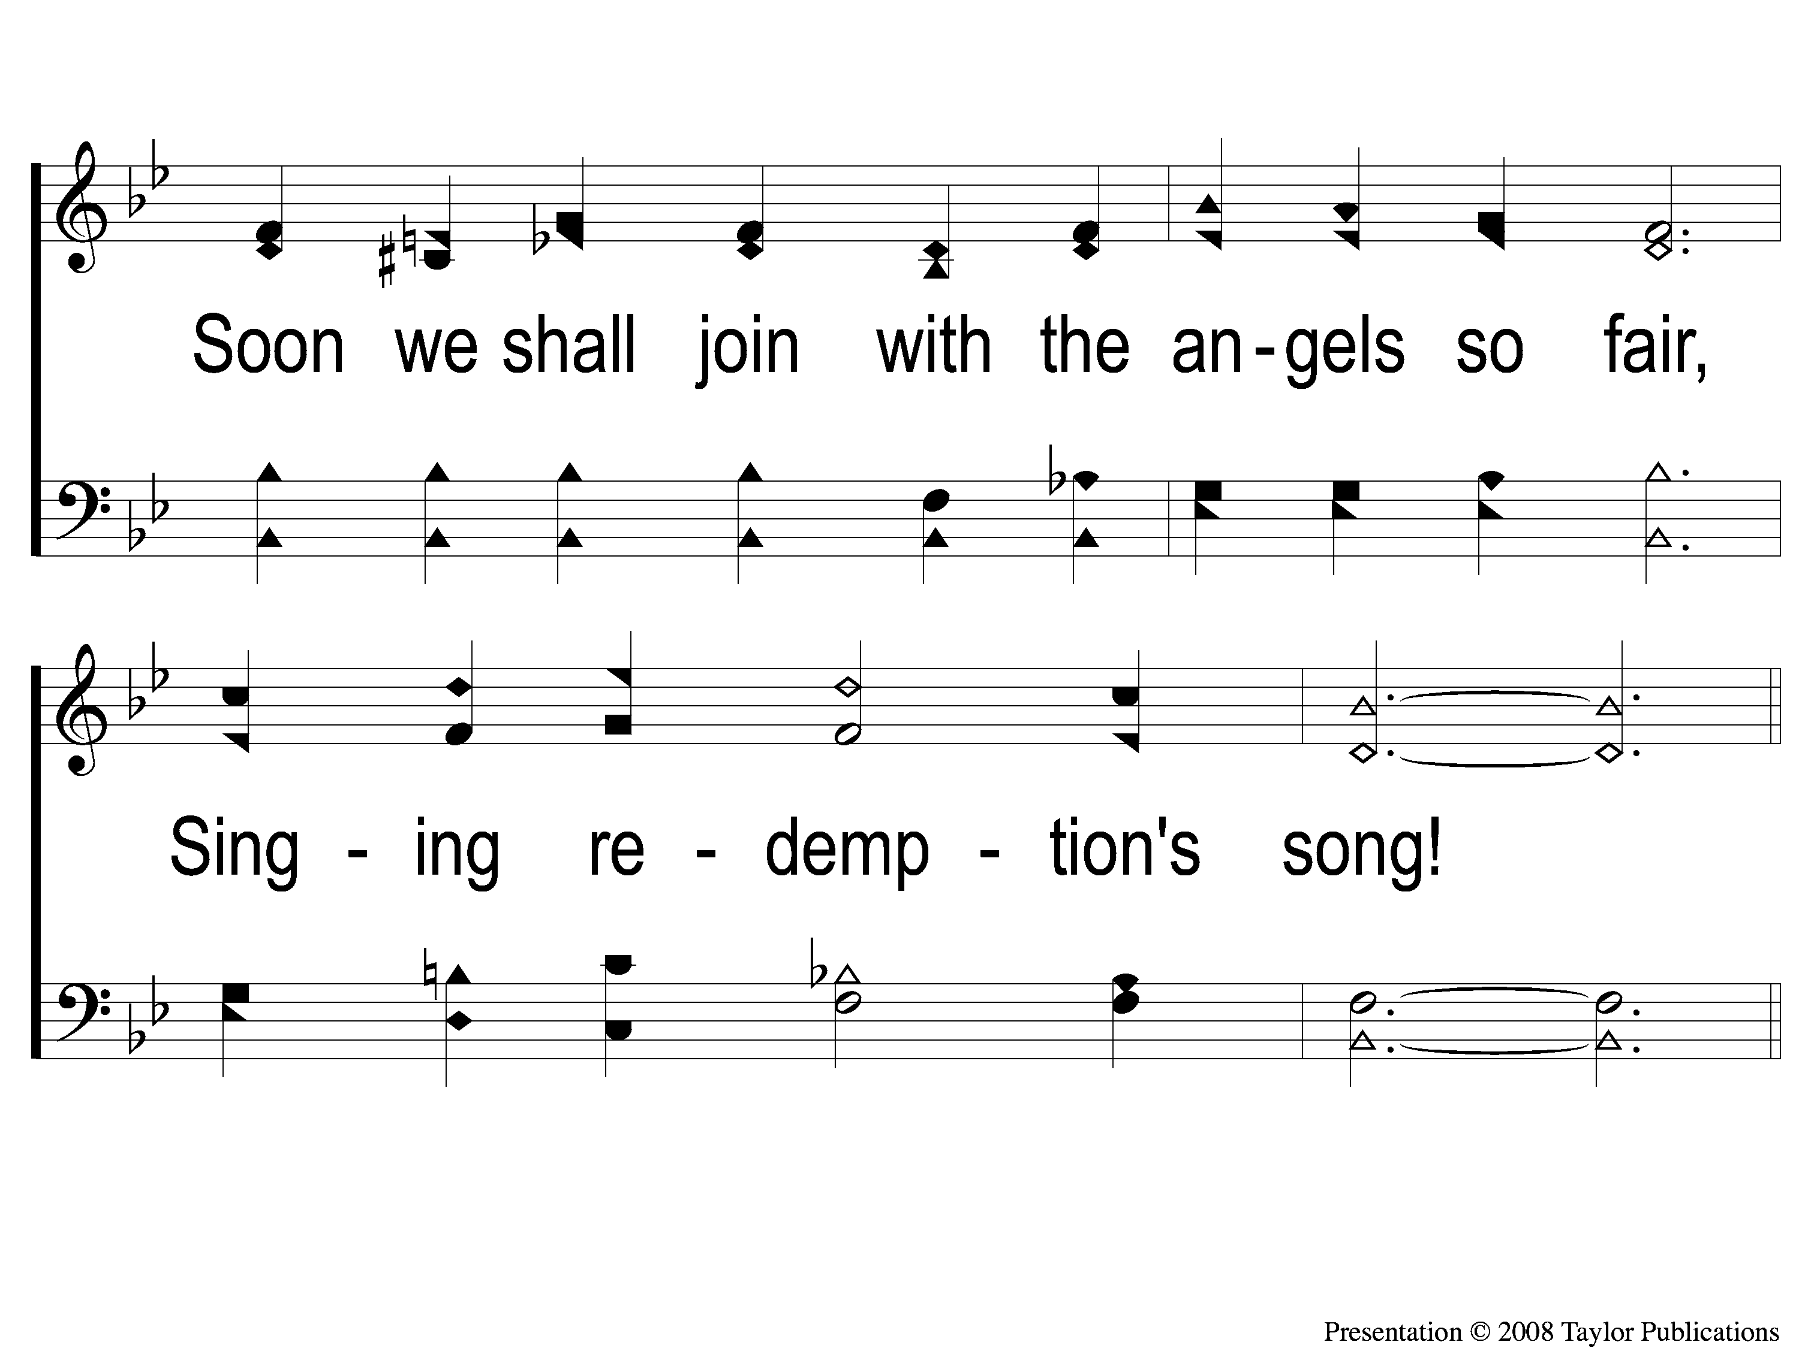
3-2 Angels are Singing
Angels Are Singing
22

Slide 15
C-1 Angels are Singing
Angels Are Singing
22

Slide 16
C-2 Angels are Singing
Angels Are Singing
22

Slide 17
C-3 Angels are Singing
Angels Are Singing
22

Slide 18
C-4 Angels are Singing
Angels Are Singing
22

